Slide 1
FAKE NEWS DETECTION USING DATA MINING
Project guide: Team Members:
K.Radha Rani N.Siva Kishore Reddy(1011602030)
Y. Pavan(1011602020)
G. Bhargava Ramani(1011602007)
P. Prema(1011602023)

Slide 2
Contents
Abstract
What is data mining?
Steps in data mining
Text classification
Existing method
Proposed method

Slide 3
Abstract
Now a days people depend much on social media for news consumption than any other conventional sources because of easy access, low cost, crispy presentation of news etc. But it also enables widespread of fake news. Such information has the potential of affecting public opinion , providing opportunity for malicious parties to degrade the fame of an organization or individual which results in loss both personally and economically. With rapid growth of big data it is almost impossible to manually filter such news. To overcome this scenario text analysis based classification approach in data mining is used in this model to detect whether a news is fake or not.
Keywords: Fake news, Text analysis, Data mining.

Slide 4
What is data mining?
Volume of information is increasing everyday that we can handle from business transactions, scientific data, pictures, videos e,t,c. So, we need a system that will be capable of extracting information available and automatically generate report or summary of data for better decision making.
Data mining is also known as KDD(Knowledge Discovery from Data).
The knowledge extracted from data helps the manager to take decisions wisely and appropriately.

Slide 5
Steps in data mining

Slide 6
Steps:
1)Data cleaning
2)Data integration
3)Data selection
4)Data transformation
5)Data mining
6)Pattern evaluation
7)Knowledge representation

Slide 7
Text classification
Text classification is the process of classifying the text into predefined categories based on their content. Text classification is primarily divided into two types.
1)Manual text classification
2)Automatic text classification
Rule based classification
Machine learning based classification
Hybrid classification

Slide 8
Existing approach
1)Linguistic approaches
Data representation
Semantic analysis
Sentiment analysis
2)Network analysis methods
Expert oriented method
Crowd sourcing method

Slide 9
Disadvantages
Less accuracy
Takes more storage
Requires human input
Less efficiency
Requires large data set
More time taking process
More chance of statistical errors

Slide 10
Proposed approach
1)Naive Bayesian Classifier
Naive Bayes is a family of statistical algorithms we can make use of when doing text classification. One of the members of that family is Multinomial Naive Bayes(MNB). One of it’s main advantages is that you can get really good results when data available is not much and computational resources are scarce.
It is based on Bayes theorem, which helps us to compute the conditional probabilities of occurrence of each individual event. This means that any vector that represents text will have the probabilities of appearance of words of text within texts of given category so that algorithm can compute likelihood of that text’s belonging to the category.

Slide 11
2)Support Vector Machines
SVM doesn’t need much training data like naive bayes but it needs more computational resources than naive bayes, and also it achieves more accurate results.
SVM will draw a line or hyperplane that divides a space into two subspaces: one subspace that contains vectors that belong to a group and another subspace that contains vectors that do not belong to that group. Those vectors are representations of your training texts and a group is a tag you have tagged your texts with.

Slide 12
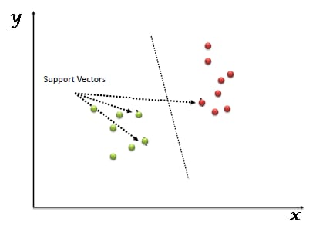
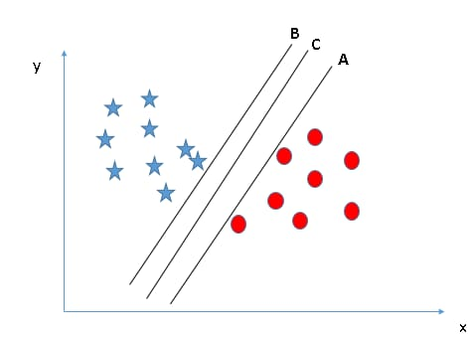


Slide 13
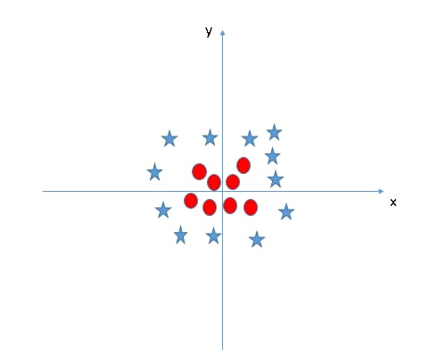
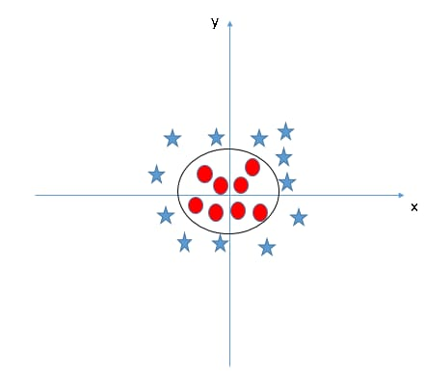

Slide 14
ANY QUERIES ?

Slide 15


